Slide 1
Neo4j Graph Database
Anju munoth

Slide 2
Neo4j
Blazing-Fast Graph, Petabyte Scale
With proven trillion+ entity performance, developers, data scientists, and enterprises rely on Neo4j as the top choice for high-performance, scalable analytics, intelligent app development, and advanced AI/ML pipelines.

Slide 3
Neo4j
Powered by a native graph database, Neo4j stores and manages data in its more natural, connected state, maintaining data relationships that deliver lightning-fast queries, deeper context for analytics, and a pain-free modifiable data model.

Slide 4
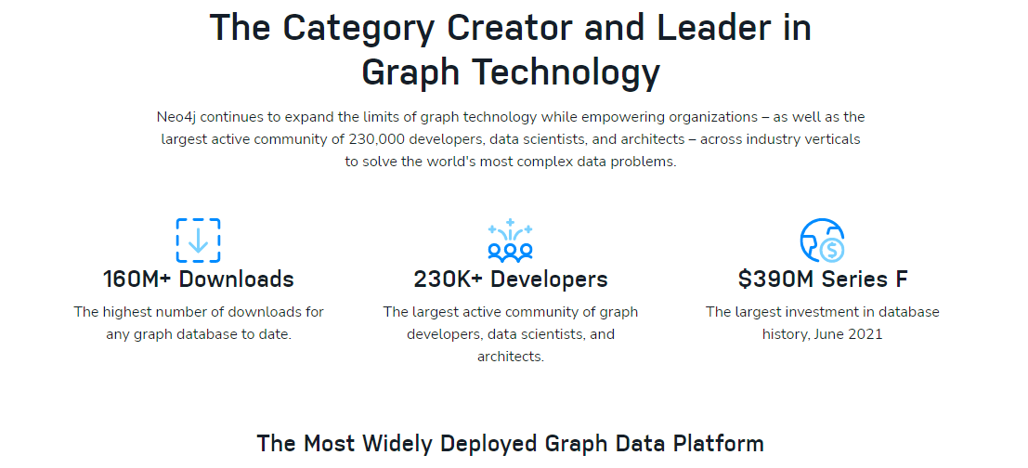

Slide 5
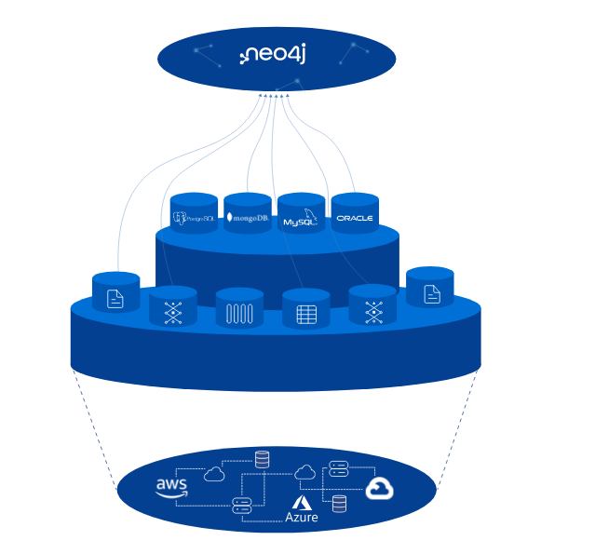

Slide 6
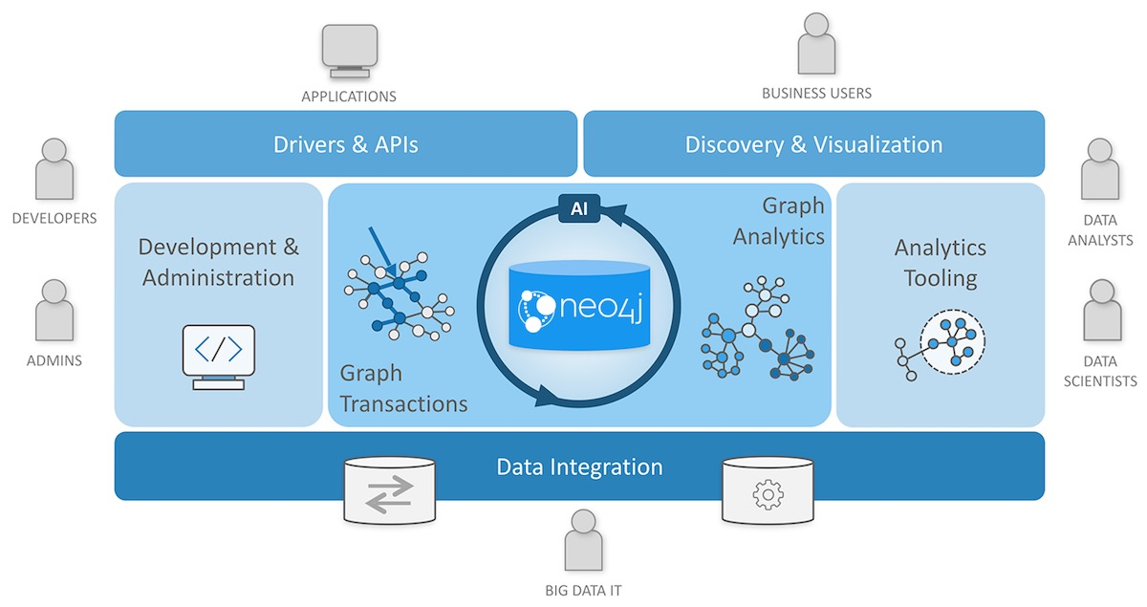

Slide 7
Components of the Neo4j Graph Platform
Neo4j Graph Database - our core graph database that is built to store and retrieve connected data. There are two editions - a Community Edition and an Enterprise Edition. Everything in our platform interacts with data stored in the database.
Neo4j Desktop - application to manage local instances of Neo4j. Free download includes Neo4j Enterprise Edition license.
Neo4j Browser - online browser interface to query and view the data in the database. Basic visualization capabilities using Cypher query language.
Neo4j Bloom - visualization tool for business users that does not require any code or programming skills to view and analyze data.
Neo4j AuraDB - database-as-a-service offering managed by Neo4j for graph databases in the cloud.
Graph Data Science - officially-supported library for executing graph algorithms with Neo4j and optimized for enterprise workloads and pipeline.

Slide 8
Key Benefits of Neo4j Graph Database

Slide 9
Lightning Fast Performance
Uncovers insights in data that other databases cannot, enabling new use cases and business models.
No matter how large your graph is or how deep the layers of your connected data are, Neo4j delivers blazingly fast responses even for the most complex queries, typically 1000x faster than relational databases

Slide 10
Unbounded Scale
Scales to support massive growth in data and users while optimizing costs.
Scale out --To keep up with high throughput while maintaining an elastic infrastructure with Autonomous Clustering.
Scale up --Divide very large graphs into shards and query them efficiently using Fabric

Slide 11
Developer Productivity
Agility to keep pace with changes in business requirements.
Data model is so intuitive that what you draw on a white board is what gets stored in the database, spurring rapid application development and innovation.
Developers can quickly build applications using their preferred languages and tools, and prototype and test on Neo4j using integrated data modeling, querying, and visualization tools.
A set of connectors plugs Neo4j right into the rest of intelligent data ecosystem

Slide 12
Operational Trust
Neo4j is the most deployed graph database in the world.
ACID compliance guarantees transactional integrity for mission critical workloads across billions of nodes and trillions of relationships, while keeping query responses to milliseconds.
Granular security is especially built for the graph.
Choice to deploy databases for intelligent applications across public, private, or hybrid clouds or in the Neo4j-managed AuraDB.
Neo4j Ops Manager reduces the complexity of self-managed deployments by giving database admins and operators UI-based control and a bird’s eye view of ops metrics

Slide 13
Features of Neo4j Graph Database

Slide 14
Performance at Scale
No joins graph traversal consistently delivers performance in milliseconds
Fast K-hop query returns results blazingly fast across multiple hops
Enhanced indexing and query planning
Autonomous Clustering for low-touch horizontal scaleout and efficient use of servers
Scale up with Fabric and query across databases or shard

Slide 15
Developer Productivity
Property graph model: what you model is what gets stored in the database
Cypher, a graph query language easier and more powerful and expressive than SQL
Official support for .Net, Java, JavaScript, Go, and Python drivers and other community supported ones; GraphQL library for rapid front-end application development
A variety of tools for low-code data modeling and loading (Data Importer), user-friendly graph query explorer (Browser), and no-code data visualization (Bloom)
A set of connectors for interoperability with the rest of your intelligent data ecosystem, including for Apache Kafka, cloud data warehouses, and business intelligence tool

Slide 16
Operational Trust
ACID compliance guarantees data integrity for OLTP/OLAP workloads
SSO and LDAP/directory services integration with your security ecosystem
RBAC for fine-grained security of all nodes, properties, and relationships
Self managed or fully managed no-ops Neo4j Aura
Neo4j Ops Manager for UI-based operations of all self-managed deployments
DevOps in the cloud with Helm Charts for Kubernetes
Batch import to load large and incremental amounts of data
Any-to-any rolling upgrades for anytime upgrades with no downtime
Differential backup and restore, including restore until a point in time

Slide 17
Unmatched Support and Services
World’s foremost graph experts in professional services and technical support
ROI maximization and project prioritization by customer success managers
Free online graph courses and paid customized trainings
Largest and most active community of graph practitioner

Slide 18
Extract Business Value from Your Graphs
Graphs are valuable inside of individual data sets, but also across them as well.
Neo4j connects disparate data by adding data relationships – this is where value multiplies by creating a data network effect that results in even more valuable graph use cases.

Slide 19
Ingest Data Faster Without Worries
Neo4j supports a vast variety of data ingestion tools for bulk load and data streaming and features staggering loading speed for even massive data sets – all with a low memory footprint.

Slide 20
Integrate With Your Systems Seamlessly
Neo4j integrates with all existing business systems, database types, and programming languages, enabling faster time to value (TTV).

Slide 21
Freedom to Deploy Anywhere, Everywhere
Neo4j offers flexible solutions and deployment models to support your cloud journey.
Run Neo4j anywhere, supporting your hybrid, lift and shift, or cloud-native environment needs. Deploy Neo4j on your cloud of choice – AWS, GCP, or Azure.

Slide 22
Modern and Intelligent
Neo4j unifies and maintains data relationships in an intuitively connected state, creating and preserving valuable context, while running lightning-fast queries.

Slide 23
Developer-Ready
With the largest, most vibrant community of graph database developers in the world, Neo4j delivers a sheer breadth of language support, APIs, and resources to quickly build intelligent applications.

Slide 24
Performance, Reliability, and Integrity
Neo4j is the only enterprise-strength graph database that combines native graph storage, scalable architecture optimized for performance, and ACID compliance to ensure rock-solid reliability.

Slide 25
Data Science and Analytics
The leader in graph technology and machine learning (ML) innovation, Neo4j offers the first and the only in-graph ML capabilities on the market.

Slide 26
Deep Market Expertise
Through years of production deployments and rigorous testing, Neo4j provides the richest experience at the right level for organizations.

Slide 27
Use Cases for Graph Technology

Slide 28
Fraud Detection
Banks and insurance companies lose billions every year to fraud.
Many companies are swapping time-consuming traditional methods with AI and machine learning.
Storing voluminous transaction detail in a graph database captures connections that already exist.
The data is then ripe for graph-native machine learning techniques that surface fraud.
Fintech firm TODO1 uses Neo4j to power a proprietary fraud detection application capable of sustaining hundreds of transactions a second, spending merely tens of milliseconds on a single query, thanks to the streamlined logic behind the Cypher query language.

Slide 29
Real-Time Recommendations
To be relevant and prevent a potential customer from clicking to a competitor, recommendations must be contextual and instantaneous.
Bechtle AG, one of the leading IT companies in Europe, has ecommerce companies in 14 countries.
With more than 40,000 products and thousands of pages on its website, Bechtle needed a solution that uses the network structure of customer interactions.
“Every day, we record hundreds of thousands of actions on our website,” explains Zoltan Kovacs, Project Manager at Bechtle.
“If we want to optimize the customer experience, we need to be able to evaluate this data in real time.”
Running in Neo4j, Bechtle’s recommendation system generates a detailed model of all the actions customers take on the website.
“We see which products end up in the shopping cart after which search terms,” said Kovacs.
“This helps us to continuously optimize the system and improve navigation for visitors and customers alike.”

Slide 30
Bill of Materials
For vehicles, durable goods, and more, tracking every component and its cost, what equipment the components relate to, and the expected product lifespan/average time to failure into a mass bill of materials (BoM) is a behemoth operation for an organization like the United States Army, which deploys a staggering amount of equipment.
The Army uses Neo4j to rapidly collect and combine this massive BoM information and save analysts huge amounts of time.
Answers are immediate.
Using Neo4j, the Army can now forecast the need for replacement parts, accurately calculate mean time to failure, and answer vital “what-if” questions about the cost of deploying forces.
Benefits include not only a more predictable total cost of ownership but assurance that equipment sent into the field will not break down thanks to effective predictive maintenance.

Slide 31
Track & Trace
Graph data models enable traceability for a variety of industries and use cases, including routing, logistics, supply chain management, and compliance.
Track and trace enables us to find out the status of a product (batch, mail/ parcel, train, ship, container, etc.) wherever it is in the supply chain and to identify and verify its path.
Think about a pharmaceutical company using track and trace to improve recall management.
Batches can be recalled for many different reasons, but the most common is the detection of faulty ingredients within a given batch.
With data from systems of record coalesced in a knowledge graph, the whereabouts of the affected batch across storage locations, wholesalers, and retailer stocks can be determined so that remedial action can be taken quickly, improving patient safety and reducing the costs associated with the recall

Slide 32
Network & IT Ops
Graph databases are a natural fit for network and IT ops; after all, a network is a graph.
The graph’s connected structure enables network managers to conduct sophisticated impact analyses.
For example, they can discover which parts of the network – applications, services, virtual machines, physical machines, data centers, routers, and switches – particular customers depend on.
Conversely, a simple graph query determines which applications, services, and customers will be affected if a particular network element fails

Slide 33
Network & IT Ops
Digital transformation requires modernizing the IT landscape and demands crystal clear visibility into current systems.
Commonwealth Bank uses Neo4j to easily map out its business applications and see relationships in a highly visual and intuitive way using graphs.
What was once a tedious chore has become a quick and easy way for Commonwealth to ensure operations remain safe, sound and secure for its customers

Slide 34
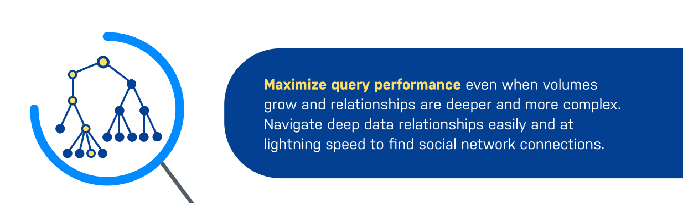

Slide 35
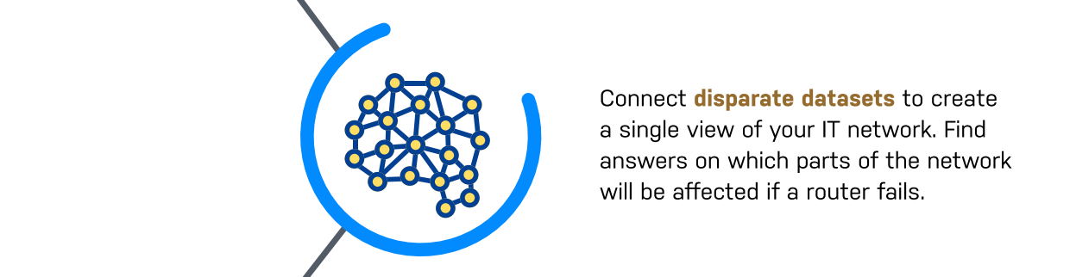

Slide 36
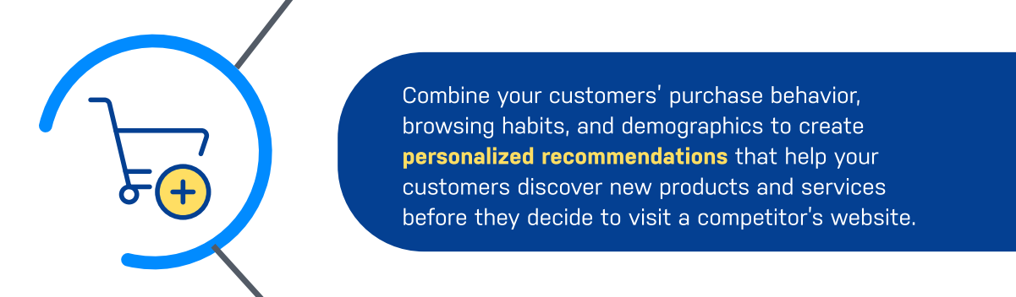

Slide 37


Slide 38


Slide 39
Neo4j as a graph database
Nodes (equivalent to vertices in graph theory). --Main data elements that are interconnected through relationships.
A node can have one or more labels (that describe its role) and properties (i.e. attributes).
Relationships (equivalent to edges in graph theory) --Connects two nodes that, in turn, can have multiple relationships.
Relationships can have one or more properties.
Labels -- Used to group nodes, and each node can be assigned multiple labels.
Labels are indexed to speed up finding nodes in a graph.
Properties --Attributes of both nodes and relationships.
Neo4j allows for storing data as key-value pairs, which means properties can have any value (string, number, or boolean).

Slide 40
 | Neo4j | Relational databases | NoSQL databases
Data storage | Graph storage structure | Fixed, predefined tables with rows and columns | Connected data not supported at the database level
Data modeling | Flexible data model | Database model must be developed from a logical model | Not suitable for enterprise architectures
Query performance | Great performance regardless of number and depth of connections | Data processing speed slows with growing number of joins | Relationships must be created at the application level

Slide 41
 | Neo4j | Relational databases | NoSQL databases
Query language | Cypher: native graph query language | SQL: complexity grows as the number of joins increases | Different languages are used but none is tailored to express relationships
Transaction support | Retains ACID transactions | ACID transaction support | BASE transactions prove unreliable for data relationships
Processing at scale | Inherently scalable for pattern-based queries | Scales through replication, but it’s costly | Scalable, but data integrity isn’t trustworthy

